Slide 1
EARIN PROJECT
Maciej Zajkowski Kacper Janus

Slide 2
Dataset:
Dataset is consisting out of three tabels: train, test and descriptions.
Test is the same table as train but wiwhout prediction labels.
Desctiptions is table consisting of id and vectorised (somehow) text describing locations. It is not
The whole dataset is based on data colected through three years. (last year is just for testing)
From task description and data we know that it is sesionail
Some hotels would be more popular in winter some in summer.
There are 100 clases (containg from around 50k examples to 1 M)

Slide 3
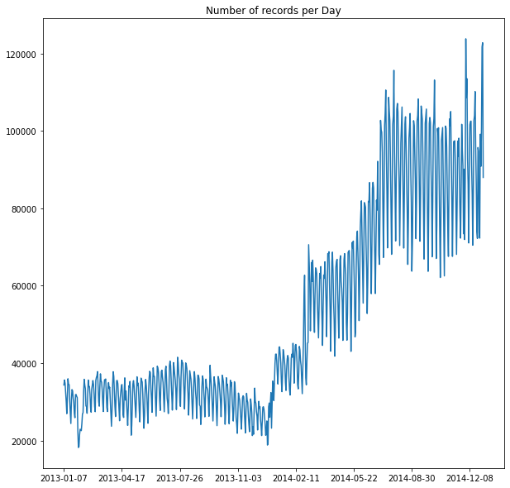
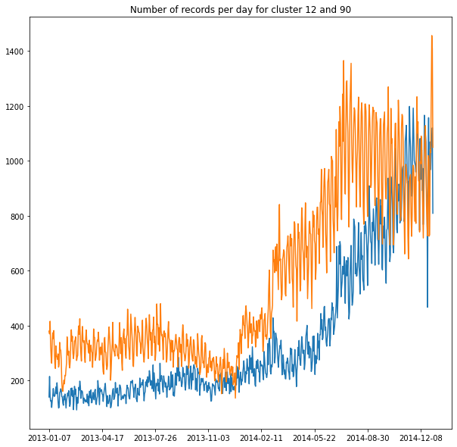

Slide 4
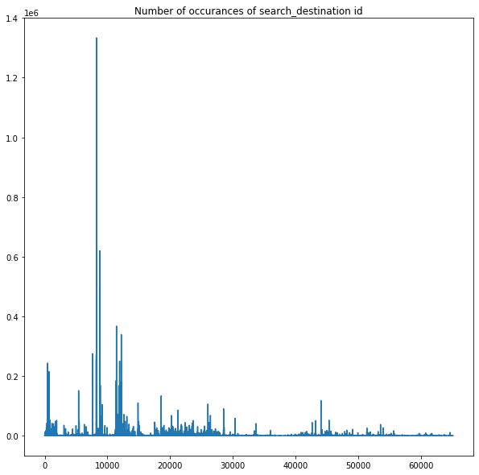
Data
We know that we must to preform dimension reduction of description vector in order for it to be trainable.
Unfortunately each description is not assigned only to one cluster ( in this way we could split problem in two and use some kind of „boosting”)
There is no need on further disscution of each data column since is is described in kaggle.

Slide 5
Metrics and methods to validate experiments
Test should be conducted on data containing all classes and all seasons
There is need to use balanced accuracy metric in order to fully evaluate our imbalanced dataset
There is probably no need to use cross validation but in case of using this technique in order to determine witch model is best, we will look by mean and std of given metric.

Slide 6
Plan of experiments
Split dataset into test and train
Create experiment tracking loop where we can train different models / with different architectures.
We can iteratively work on improving our models ( based on previous results we can modify each feature, or hiperparameter)
Only after first success we can try to add descriptions data to our model since it has data that is not strictly related to hotel clusters, and we suspect that it could be the hardest part of project.

Slide 7
Algorithms that will be used:
Neural networks (it should work fine since we have a lot of data)
Random forests - it is composed from diffrent decision treas that are trained to look for specific feature, than we have majority voting.
Dimension – reduction algorithms – based on unsupervised learning clusters are created and they will be used in order to minimalise computing power needet to train models.

Slide 8
Reasarch GoaL
To messure how diffrent models react to diffrent numer of the data
Models to be used: XTBFRC
Model based on nn
Model bassed on nn but table is created to image using IGTD algorithm

Slide 9

Code https://github.com/MaciejZajkowski/EARIN-PROJ
What has been done:
training for XGBRFC
Function for preprocessing and loading data
First image creation
Problems that we encoutred: 1. lack of reasources – we cannnot load whole dataset on ram memory 2. time of running – it takes a lot to train for example Random search on GBRFC with 50k lasted almoust 2 hours

Slide 10
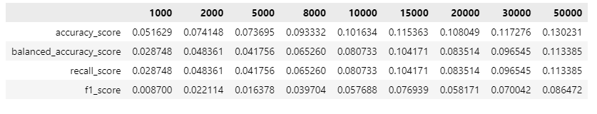
XGBRFC

Slide 11
